Slide 1

My google Analytics CAPSTONE PROJECT October 2022 BY F.I.G.L.

Slide 2
Case study: How Does a Bike-Share Navigate Speedy Success?
This case study provided a set of bike trip data of the Cyclistic bike-share company covering the past twelve months, to which the Google Analytics process was applied in order to comply with the business task. The following slides describe the process and finally illustrate the findings and recommendations.

Slide 3
Google Analytics process Phase 1
ASK
PREPARE > PROCESS > ANALYZE > SHARE > ACT
During the ASK phase a Clear Statement of the Business Task was formed based on the requirements provided in the case study.
The goal was to find the answer to the following question using the data provided:
How do Casual and Annual riders differ in bike usage and how can this difference be used best to reach and influence Casual riders to become Annual riders, while using digital channels.
Furthermore, the website of the real company behind the one in the case study was consulted to obtain additional company information since additional questions could not be posed to the fictitious stakeholders.

Slide 4
Google Analytics process Phase 2
ASK > PREPARE
PROCESS > ANALYZE > SHARE > ACT
During the PREPARE phase a hypothesis was setup:
Casual members take less but longer bike trips than
Annual riders.
The hypothesis was reached after:
Performing evaluation of the source, credibility, integrity, usefulness and license details of the data with positive results
Downloading, securing and reviewing the data set to familiarize with its contents and organization; the data set consisted of twelve .csv files each consisting of 100K to 650K rows
Ensuring the data had no issues that could not be mitigated with cleaning and or manipulation

Slide 5
Google Analytics process Phase 3
ASK > PREPARE >
PROCESS
ANALYZE > SHARE > ACT
During the PROCESS phase :
The data set was closely examined to plan for analysis. A subset of the data, consisting of the smaller files were combined into one file (the winter season), cleaned and manipulated using MS Excel. This exercise served to decide:
The required columns to be used in analysis: the Start Time and End Time of each trip / row
The completeness and formats of this portion of the data: confirming no missing data and equal and correct format
What calculated columns were required in order to obtain additional insights: added a column which calculated the day of week based on the Start Time column
Additionally, the size of the total data was considered in order to decide the choice of an additional tool to combine all separate files into one single data file and conduct final analysis: RStudio Desktop was chosen to handle the combined data after evaluation of MS Excel Power Query and Data Model

Slide 6
Google Analytics process Phase 4
ASK > PREPARE > PROCESS
ANALYZE
SHARE > ACT
During the ANALYZE phase:
Pre-analysis using MS Excel was conducted on the subset of the data, which included visualizations
Statistical calculations were performed on the subset and this resulted in additional requirement for specific formatting of relevant columns as well as for the removal of rows where trip length was zero
The analysis results in MS Excel, provided pre-liminary answers to the business questions and hence, the actions taken became the planned analysis method for the combined data in RStudio
In RStudio, the files were comined and the planned analysis was performed. While setting up visualizations, some values were renamed to improve compliance with the 5-sec rule of compelling visualizations

Slide 7
Google Analytics process Phase 5
ASK > PREPARE > PROCESS
ANALYZE >
SHARE > ACT
During the SHARE phase, the following visualizations/plots were setup using RStudio Desktop:
A Column chart to illustrate the Annual : Casual riders ratio
A Clustered Column chart to compare the number of rides by Annual and Casual rides during working weekdays, where Annual members rode almost twice as often as Casual riders, compared to weekends where Casual riders took more rides than Annual members
A Clustered Column chart to illustrate that on all weekdays the average trip length of Casual riders was nearly twice as long as that of Annual members

Slide 8
Google Analytics process Phase 6
ASK > PREPARE > PROCESS
ANALYZE >SHARE
ACT
During the ACT phase, the insights that were drawn from the data and visualizations resulted in the following 3 recommendations to the board:
Casual riders took, on average, trips that lasted twice as long as the Annual members and thereby paid the monthly membership fee in a single monthly ride; this information in order to save on rides for the rest of the year
Casual riders chose the more expensive e-bikes almost as often as the Annual members; the lower cost of e-bikes for Annual members should be used as an incentive for the riders convert
Riders are required to download the Cyclistic app in order to unlock a bike in most stations. This app is the recommended digital channel to provide the Casual rider with insights on missed savings

Slide 9
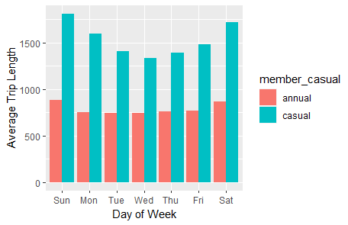
Supporting Insights & Recommendations
Casual riders trips were 2x longer than Annual members
Recommendation #1:
Casual riders paid the monthly membership fee $9 in a single monthly ride; this information in order to save on rides for the rest of the year.

Slide 10
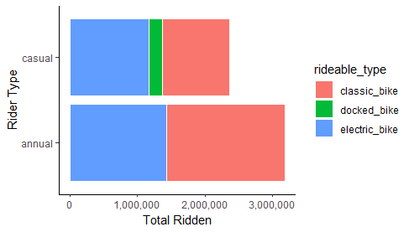
Supporting Insights & Recommendations
Casual riders chose the more expensive e-bikes for over 40% of their rides
Recommendation#2:
The lower cost of e-bikes for Annual members should be used as an incentive for the Casual riders convert.

Slide 11
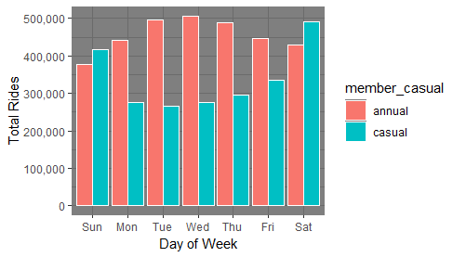
Supporting Insights & Recommendations
Casual riders took more rides during weekends
Recommendation#3:
Use the Cyclistic app as the digital channel to persuade the Casual riders with insights on missed savings and increase the frequency during the weekends.

